Slide 1
Reduction to Relation Schemas

Slide 2

E-R Diagram for a University Enterprise

Slide 3
Reduction to Relation Schemas
Entity sets and relationship sets can be expressed uniformly as relation schemas that represent the contents of the database.
A database which conforms to an E-R diagram can be represented by a collection of schemas.
For each entity set and relationship set there is a unique schema that is assigned the name of the corresponding entity set or relationship set.
Each schema has a number of columns (generally corresponding to attributes), which have unique names.

Slide 4

Representing Entity Sets
A strong entity set reduces to a schema with the same attributes
student(ID, name, tot_cred)
A weak entity set becomes a table that includes a column for the primary key of the identifying strong entity set
section ( course_id, sec_id, semester, year )

Slide 5

Representing Relationship Sets
A many-to-many relationship set is represented as a schema with attributes for the primary keys of the two participating entity sets, and any descriptive attributes of the relationship set.
Example: schema for relationship set advisor
advisor = (s_id, i_id)

Slide 6

Representation of Entity Sets with Composite Attributes
Composite attributes are flattened out by creating a separate attribute for each component attribute
  Example: given entity set instructor with composite attribute name with component attributes first_name and last_name the schema corresponding to the entity set has two attributes name_first_name and name_last_name
    Prefix omitted if there is no ambiguity (name_first_name could be first_name)
Ignoring multivalued attributes, extended instructor schema is
  instructor(ID,
  first_name, middle_initial, last_name,
  street_number, street_name,
  apt_number, city, state, zip_code,
  date_of_birth)

Slide 7
Representation of Entity Sets with Multivalued Attributes
A multivalued attribute M of an entity E is represented by a separate schema EM
Schema EM has attributes corresponding to the primary key of E and an attribute corresponding to multivalued attribute M
Example: Multivalued attribute phone_number of instructor is represented by a schema:
inst_phone= ( ID, phone_number)
Each value of the multivalued attribute maps to a separate tuple of the relation on schema EM
  For example, an instructor entity with primary key 22222 and phone numbers 456-7890 and 123-4567 maps to two tuples:
  (22222, 456-7890) and (22222, 123-4567)

Slide 8

Redundancy of Schemas
Many-to-one and one-to-many relationship sets that are total on the many-side can be represented by adding an extra attribute to the “many” side, containing the primary key of the “one” side
Example: Instead of creating a schema for relationship set inst_dept, add an attribute dept_name to the schema arising from entity set instructor

Slide 9
Redundancy of Schemas (Cont.)
For one-to-one relationship sets, either side can be chosen to act as the “many” side
  That is, an extra attribute can be added to either of the tables corresponding to the two entity sets
If participation is partial on the “many” side, replacing a schema by an extra attribute in the schema corresponding to the “many” side could result in null values

Slide 10
Redundancy of Schemas (Cont.)
The schema corresponding to a relationship set linking a weak entity set to its identifying strong entity set is redundant.
Example: The section schema already contains the attributes that would appear in the sec_course schema

Slide 11

Non-binary Relationship Sets
Most relationship sets are binary
There are occasions when it is more convenient to represent relationships as non-binary.
E-R Diagram with a Ternary Relationship

Slide 12
Cardinality Constraints on Ternary Relationship
We allow at most one arrow out of a ternary (or greater degree) relationship to indicate a cardinality constraint
For example, an arrow from proj_guide to instructor indicates each student has at most one guide for a project
If there is more than one arrow, there are two ways of defining the meaning.
  For example, a ternary relationship R between A, B and C with arrows to B and C could mean
    1. Each A entity is associated with a unique entity from B and C or
    2. Each pair of entities from (A, B) is associated with a unique C entity, and each pair (A, C) is associated with a unique B
  Each alternative has been used in different formalisms
  To avoid confusion we outlaw more than one arrow

Slide 13
Specialization
The process of designating subgroupings within an entity set is called specialization.
Top-down design process; we designate sub-groupings within an entity set that are distinctive from other entities in the set.
These sub-groupings become lower-level entity sets that have attributes or participate in relationships that do not apply to the higher-level entity set.
Attribute inheritance– a lower-level entity set inherits all the attributes and relationship participation of the higher-level entity set to which it is linked.

Slide 14

Specialization Example
employee and student
instructor and secretary

Slide 15
Representing Specialization via Schemas
Method 1:
  Form a schema for the higher-level entity
  Form a schema for each lower-level entity set, include primary key of higher-level entity set and local attributes
  Drawback: getting information about, an employee requires accessing two relations, the one corresponding to the low-level schema and the one corresponding to the high-level schema
schema attributes
person ID, name, street, city
student ID, tot_cred
employee ID, salary

Slide 16
Representing Specialization as Schemas (Cont.)
Method 2:
  Form a schema for each entity set with all local and inherited attributes
  Drawback: name, street and city may be stored redundantly for people who are both students and employees
schema attributes
person ID, name, street, city
student ID, name, street, city, tot_cred
employee ID, name, street, city, salary

Slide 17
Generalization
A bottom-up design process – combine a number of entity sets that share the same features into a higher-level entity set.
Specialization and generalization are simple inversions of each other; they are represented in an E-R diagram in the same way.
The terms specialization and generalization are used interchangeably.

Slide 18
Design Constraints on a Specialization/Generalization
Completeness constraint -- specifies whether or not an entity in the higher-level entity set must belong to at least one of the lower-level entity sets within a generalization.
  total: an entity must belong to one of the lower-level entity sets
  partial: an entity need not belong to one of the lower-level entity sets
Partial generalization is the default. We can specify total generalization in an ER diagram by adding the keyword total in the diagram and drawing a dashed line from the keyword to the corresponding hollow arrow-head to which it applies (for a total generalization), or to the set of hollow arrow-heads to which it applies (for an overlapping generalization).
The student generalization is total: All student entities must be either graduate or undergraduate. Because the higher-level entity set arrived at through generalization is generally composed of only those entities in the lower-level entity sets, the completeness constraint for a generalized higher-level entity set is usually total

Slide 19

Aggregation
  Consider the ternary relationship proj_guide, which we saw earlier
  Suppose we want to record evaluations of a student by a guide on a project

Slide 20
Aggregation (Cont.)
Relationship sets eval_for and proj_guide represent overlapping information
  Every eval_for relationship corresponds to a proj_guide relationship
  However, some proj_guide relationships may not correspond to any eval_for relationships
    So we can’t discard the proj_guide relationship
Eliminate this redundancy via aggregation
  Treat relationship as an abstract entity
  Allows relationships between relationships
  Abstraction of relationship into new entity

Slide 21

Aggregation (Cont.)
Eliminate this redundancy via aggregation without introducing redundancy, the following diagram represents:
  A student is guided by a particular instructor on a particular project
  A student, instructor, project combination may have an associated evaluation

Slide 22
E-R Design Decisions
The use of an attribute or entity set to represent an object.
Whether a real-world concept is best expressed by an entity set or a relationship set.
The use of a ternary relationship versus a pair of binary relationships.
The use of a strong or weak entity set.
The use of aggregation – can treat the aggregate entity set as a single unit without concern for the details of its internal structure.

Slide 23

Summary of Symbols Used in E-R Notation

Slide 24
Symbols Used in E-R Notation (Cont.)

Slide 25
More Examples (OLD) and Tutorial

Slide 26
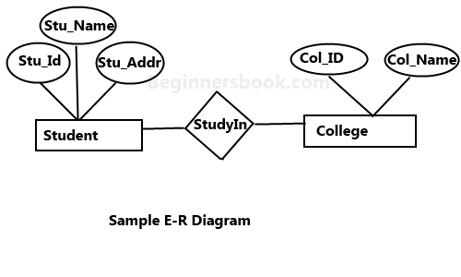
In the following diagram we have two entities Student and College and their relationship. The relationship between Student and College is many to one as a college can have many students however a student cannot study in multiple colleges at the same time. Student entity has attributes such as Stu_Id, Stu_Name & Stu_Addr and College entity has attributes such as Col_ID & Col_Name.

Slide 27
Rectangle: Represents Entity sets.
Ellipses: Attributes
Diamonds: Relationship Set
Lines: They link attributes to Entity Sets and Entity sets to Relationship Set
Double Ellipses: Multivalued Attributes
Dashed Ellipses: Derived Attributes
Double Rectangles: Weak Entity Sets
Double Lines: Total participation of an entity in a relationship set
An ER diagram has three main components:
1. Entity
2. Attribute
3. Relationship

Slide 28
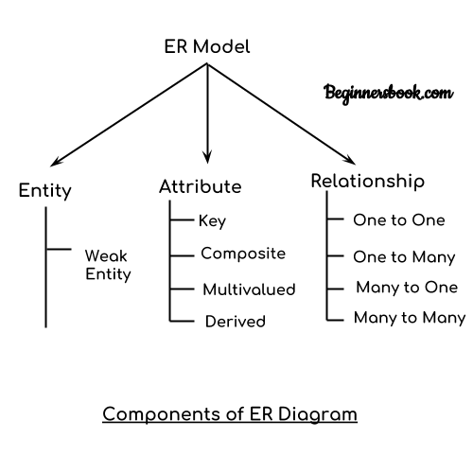

Slide 29
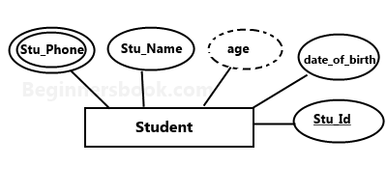
E-R diagram with multivalued and derived attributes:

Slide 30
Tutorial
All students have to make at least five ER diagrams for practice. Above should be done:
Using New Notations.
Using Old Notations.

Slide 31
Reference
System Concepts
Abraham Silberschatz, Henry F. Korth, S. Sudarshan
Tata McGraw-Hill

